Slide 1

AIERD
Artificially Intelligent Emergency
Response Drone
An AI based Search & Rescue Drone

Slide 2
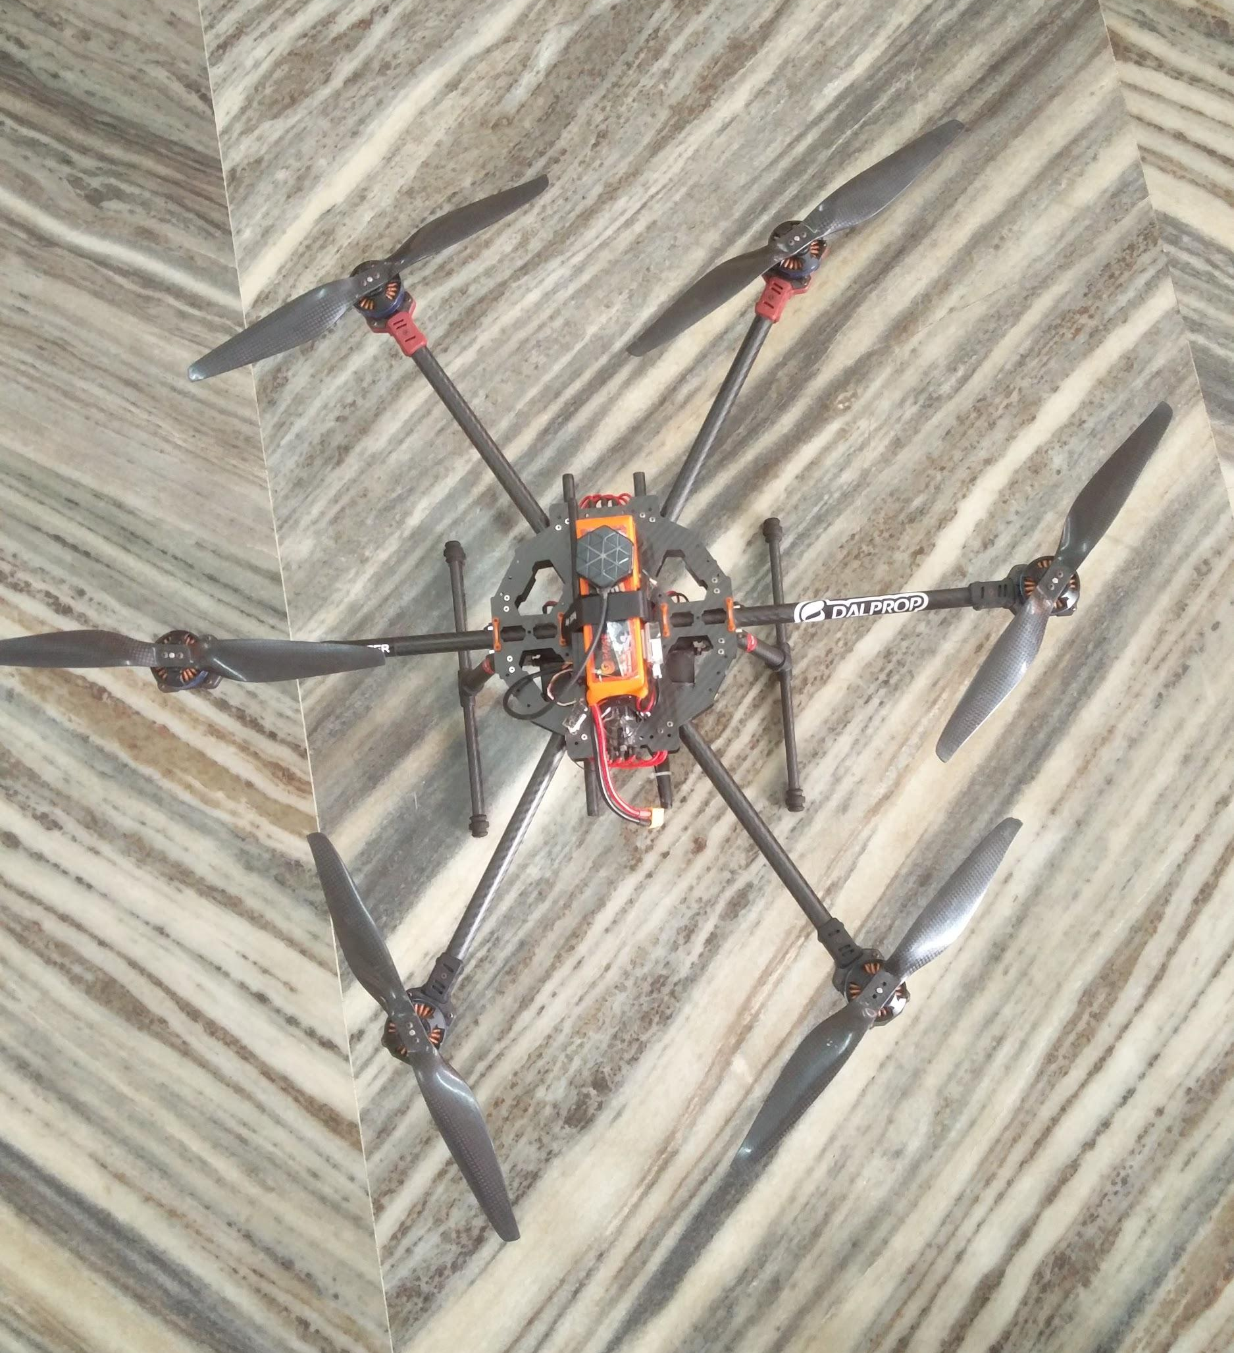
The Prototype
An AI based Drone designed to aid in Search & Rescue
Uses Deep Learning to detect people in distress during calamities like floods
On-board camera & sensors
Aids first responders to quickly locate people
High payload capacity to deploy emergency survival packs
The above picture depicts first AIERD prototype build progress

Slide 3
The Working
Operator maps the path of the target location
The AIERD flies over the location, looking for people in distress.
If found, GPS location sent to First Responder
Payload capacity for deploying aids such as medicines
Upto 30 min flight time.
Redundant RF Link
LTE capabilities for live stream

Slide 4
Detailed Working
Jetson TX2 works as the Flight Computer running FlytOS, the Operating System. Hosts the Neural Network.
Operator maps the area as way-points
AIERD takes off to the way-points & searches for people stuck on rooftops etc.
Done using Neural Network with image classifier
If a valid case is found, the GPS location is sent to base station. Live video is available to the operator.

Slide 5
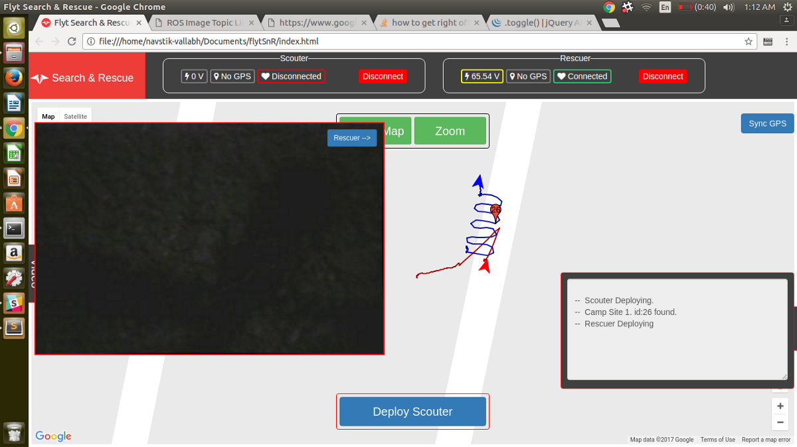
Simulated Search & Rescue mission

Slide 6
Milestones
December
Conception of the idea
February
Purchased necessary components
April
Completed the hardware build
2018
DEPLOYMENT
2019
March
Began construction of the drone element
May
Integrating the
Neural Network
January
Finalized the idea & the design

Slide 7
Work Plan
1
December
Week - 1
Feasibility study
2
January
Week - 4
Hardware planning
Component study
3
February
Week - 1
Component purchase
4
Started programming & compilation of nodes
March
Week - 1
5
Began build of the drone
March
Week - 3
6
Completed hardware & began cross-compilation of nodes
April
Week - 2
7
Integrate Neural Network & Final deployment
May
Week - 4

Slide 8
Competition
Main competition, Chinese Manufacturer DJI
DJI is a commercial drone manufacturer
DJI works on conventional algorithms for image processing and in turn is less effective
AIERD uses software made in India
AIERD is more flexible in terms of both hardware & software
AIERD can be custom build to specific application
Better accuracy can be achieved over time

Slide 9
Features
AIERD
DJI
Comparison
Open Source
AIERD is a semi open-source project
1
Flexibility
AIERD is highly flexible both in terms of software & hardware
2
Ease of use
3
DJI is easier to use and is ready to fly out-of-the box
Upgradeability
4
AIERD has the ability to upgrade its features for better adaptability to scenarios
AIERD is significantly less expensive than competition
5
Affordability

Slide 10
Advantage Disadvantage
Highly configurable
Flexible hardware & software
Deep Learning improves the accuracy each time
Level 3 Autonomy
Payload capacity
Swarm flights
Can cover a large area in a single flight
Requires on site training
Less efficient design compared to commercial drones.
Can only work during relatively calm wind speeds
Requires FlytCloud for 4G live stream; paid service

Slide 11
Conclusion
The AIERD is a custom solution for most Search & Rescue operations
Can aid First Responders in quickly covering ground
Autonomous flight reduce manual intervention
Deep Learning networks deployed improve over time
Cost effective
Swarm formation capability for faster ground coverage
Time saving

